Slide 3
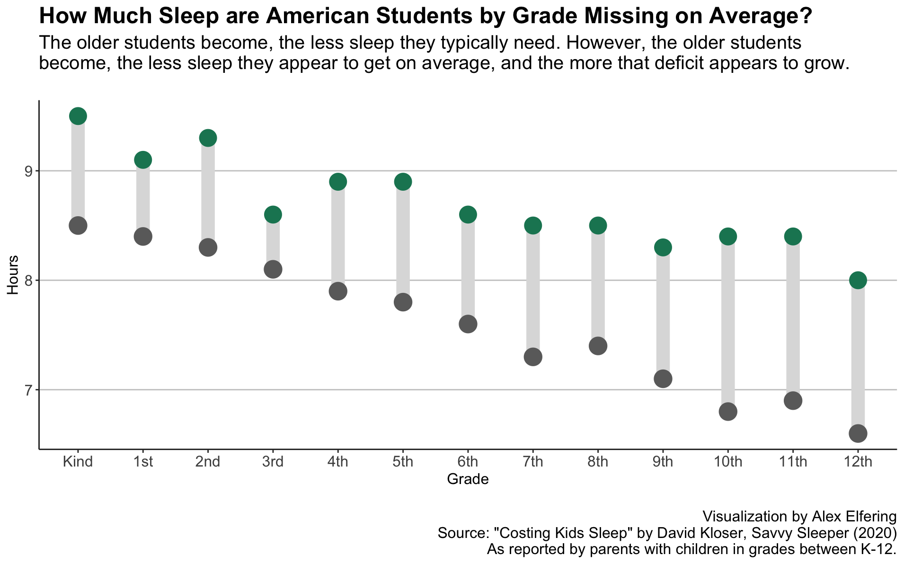
What the CDC recommends
The discrepancy is largest among 10th graders.
What students get

Slide 4
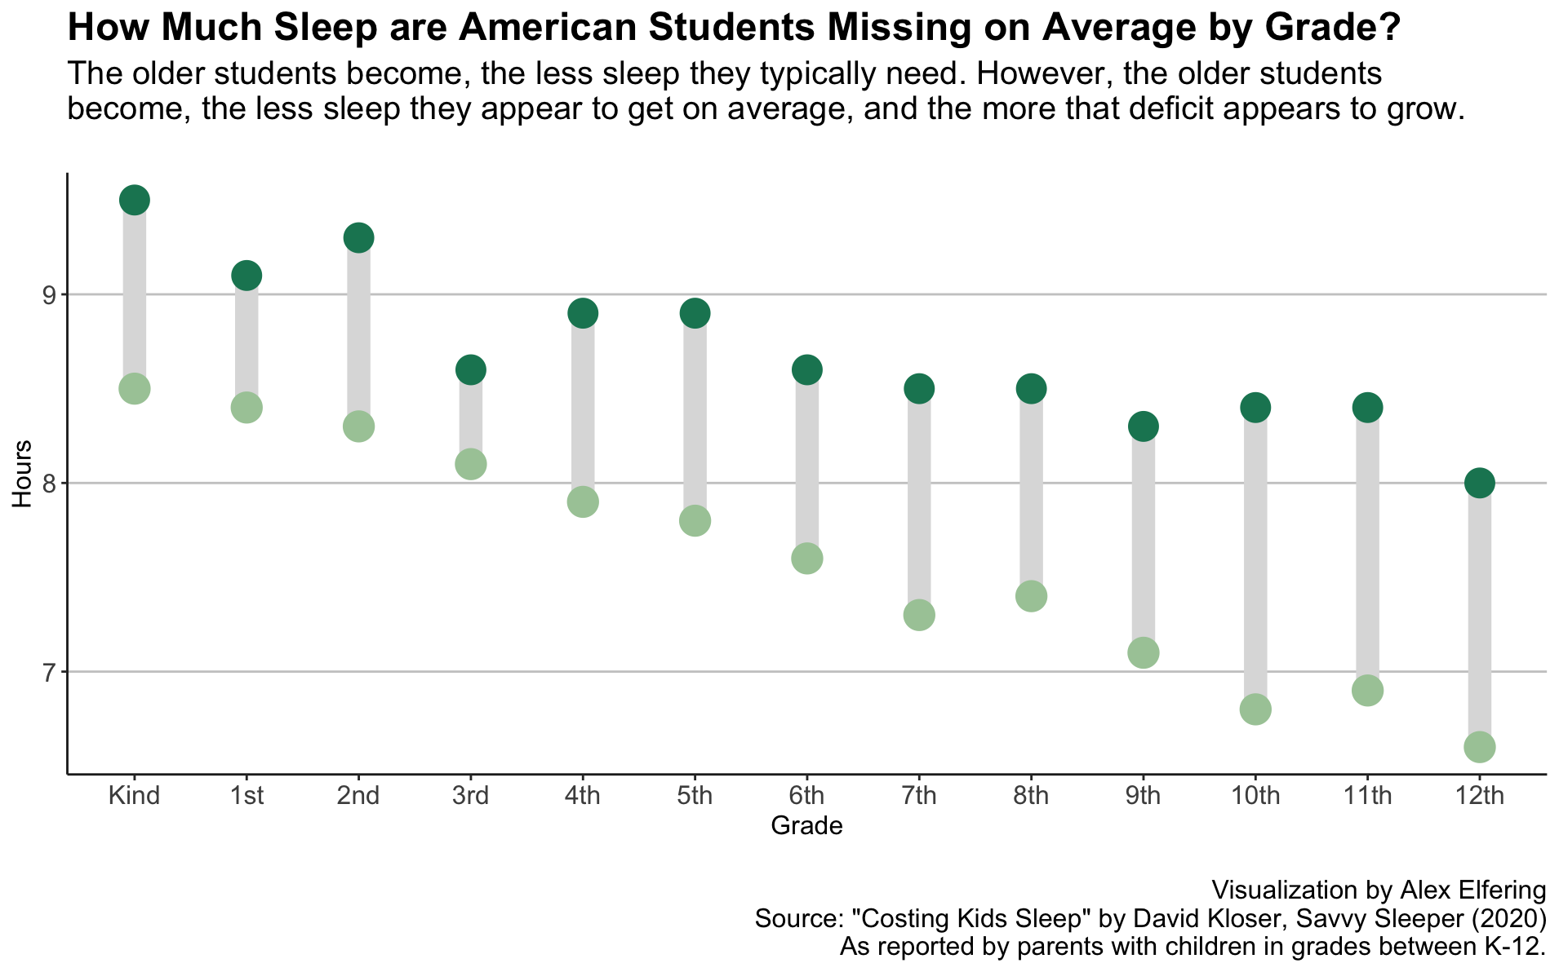
What the CDC recommends
The discrepancy is largest among 10th graders.
What students get

